Slide 1


Clinical Trial Data System
Done by Mr. Jayasakthi J
Notes:
‹#›

Slide 2
CHALLENGE
Problem Definition
Data Complexity
System Issues
Tracking Difficulties
Solution Need
Clinical trial data is large, sensitive, and complex to manage effectively.
Manual or unstructured systems cause data inconsistency and errors.
Need a centralized, reliable database system for all trial data.
Difficult to track patients, trials, drugs, and results across systems.
Notes:
‹#›

Slide 3





Stakeholders & Business Context
Key Stakeholders
Business Context
Researchers
Drug testing and approval process
Accurate result tracking
Regulatory compliance
Conduct studies and analyze data
Doctors
Monitor patient health and safety
Patients
Participate in clinical trials
Pharma Companies
Develop and test new drugs
Regulatory Authorities
Ensure compliance and safety
Notes:
‹#›

Slide 4

Functional Requirements
Core Functions
Register Patients
Capture patient information securely
Create Clinical Trials
Set up new trial protocols
Assign Patients to Trials
Match eligible patients with studies
Record Drug Details
Document medication information
Store Trial Results
Capture and preserve outcomes
Generate Reports
Create comprehensive analytics
Business Rules: One patient can join multiple trials. One trial can test multiple drugs. Results must be valid values.
Notes:
‹#›

Slide 5
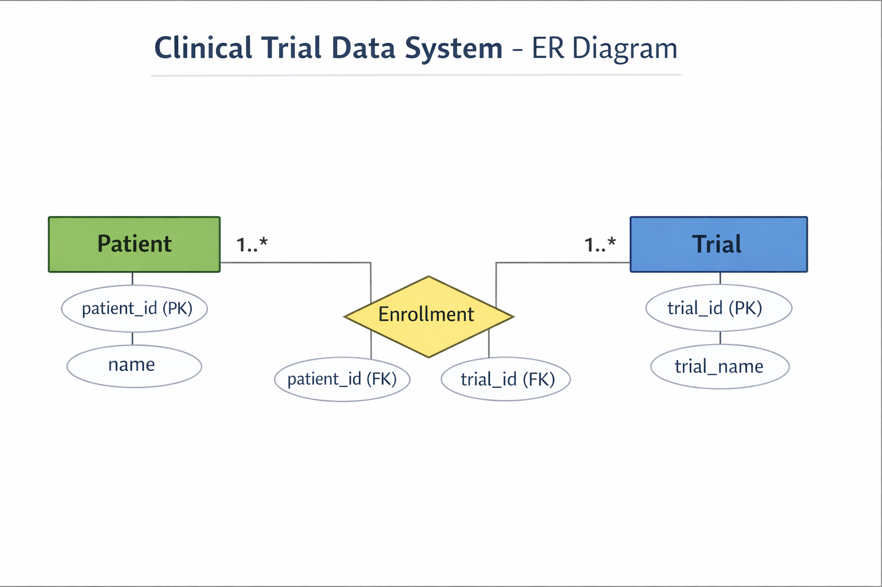
DATA MODEL
ER Diagram: Conceptual Data Model
Patient
Clinical Trial
Individual receiving treatment
Study evaluating one or more drugs
Drug
Trial Enrollment
Investigational medicinal product
Junction resolving patient-trial M:N
The conceptual model shows how patients, trials, drugs, enrollments, and results relate to each other. The many-to-many relationship between patients and trials is resolved through the Trial_Enrollment junction table.
Notes:
‹#›

Slide 6


Logical Data Model
Resolved M:N Relationship
1
Patient ↔ Trial relationship resolved through Trial_Enrollment junction table
Cardinality Rules
Patient → Enrollment (1:N)
Trial → Enrollment (1:N)
Trial → Drug (1:N)
2
Data Constraints
3
Unique (patient_id, trial_id)
Mandatory foreign keys
Notes:
‹#›

Slide 7
IMPLEMENTATION
Physical Model: SQL Tables
Create Database
1
CREATE DATABASE clinical_trial;
USE clinical_trial;
2
Create Patient Table
CREATE TABLE Patient (
patient_id INT PRIMARY KEY,
name VARCHAR(50)
);
Create Trial Table
3
CREATE TABLE Trial (
trial_id INT PRIMARY KEY,
trial_name VARCHAR(50)
);
4
Create Enrollment Table
CREATE TABLE Enrollment (
patient_id INT,
trial_id INT
);
Insert Sample Data
5
INSERT INTO Patient VALUES (1,'Arun');
INSERT INTO Trial VALUES (101,'Covid Vaccine Trial');
INSERT INTO Enrollment VALUES (1,101);
6
Retrieve Data
SELECT p.name, t.trial_name
FROM Patient p, Trial t, Enrollment e
WHERE p.patient_id = e.patient_id
AND t.trial_id = e.trial_id;
Notes:
‹#›

Slide 8









Conclusion
Data Accuracy
Easy Tracking
Research Support
Easy tracking of trials and patients in one system
Ensures data accuracy and integrity across all trials
Supports medical research decisions with reliable data
Scalable & Secure
Scalable and secure SQL-based system for growth
Notes:
‹#›

